Slide 1
Gradient-based Learning Applied to Document Recognition
Prashant anand Ranjan
21105066
M-Tech - ME
EE656A

Slide 2
BACKGROUND
Authors
Yann LeCun
Leon Bottou
Yoshua Bengio
Patrick Haffner
Presented in
Proceedings of the IEEE journal in 1998

Slide 3
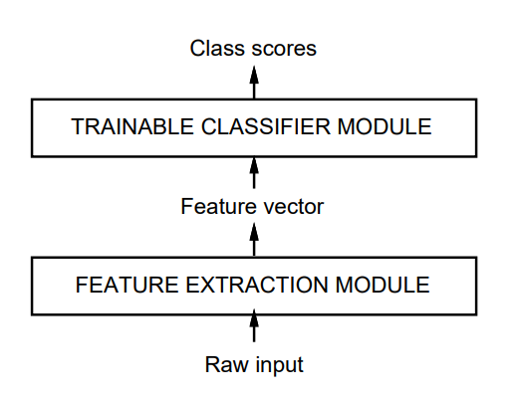
INTRODUCTION
Traditional approach
Feature Extraction Module
Trainable Classifier Module
Limitations in traditional approach
Feature extraction is mostly hand-crafted
Classifiers use low-dimensional spaces
Enabling the use of high-dimensional spaces
Availability of low-cost machines
Availability of large databases
Availability of powerful machine learning techniques
Why gradient-based learning
Complex decision surface -> high dimensional patters
Minimal pre-processing requirements

Slide 4
CONVOLUTIONAL NEURAL NETWORKS FOR ISOLATED CHARACTER RECOGNITION

Slide 5
Convolution Networks
Convolutional Neural Networks is the standard form of neural network architecture for solving tasks associated with images.
It provide solutions for tasks such as object detection, face detection, pose estimation and more.
A few characteristic of the CNN architecture
Local Receptive Fields
Sub-Sampling
Weight Sharing

Slide 6
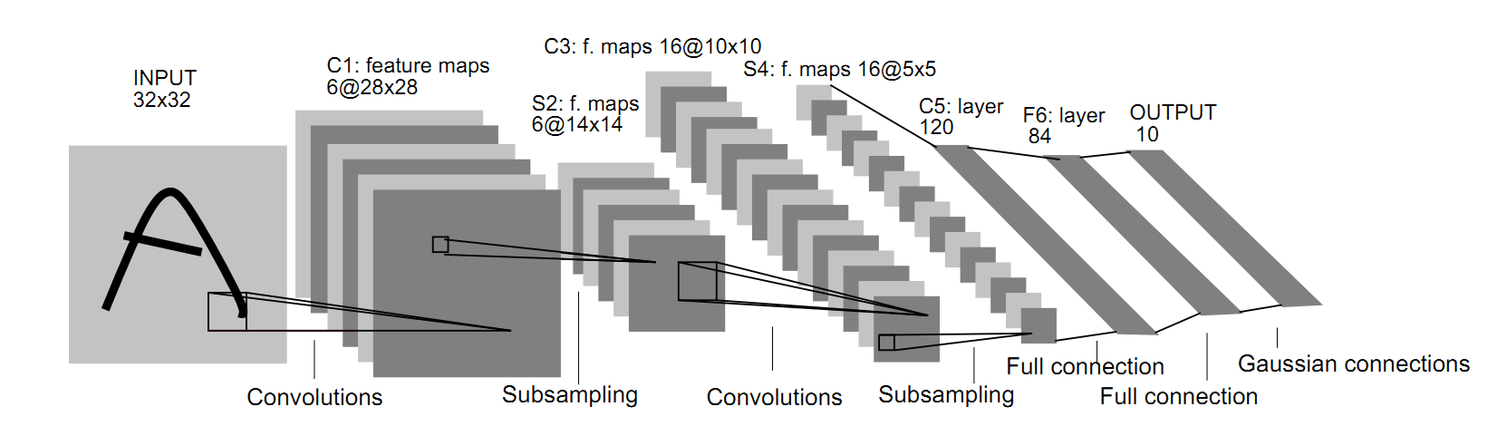
LeNet - 5
LeNet – 5 CNN architecture is made up of 7 layers.
3 Convolutional layers
2 Subsampling layers
2 Fully connected layers

Slide 7
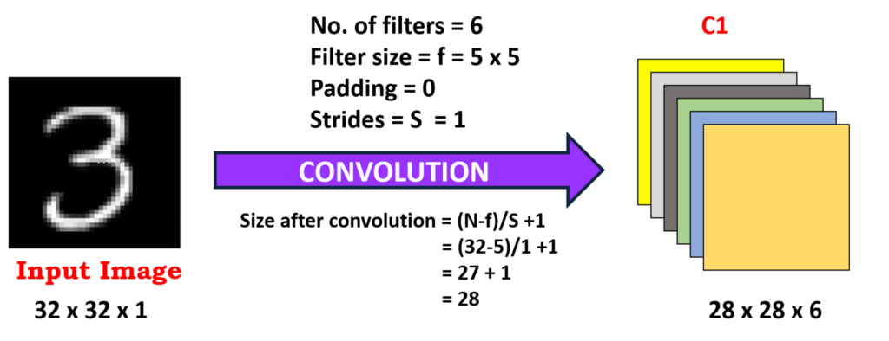
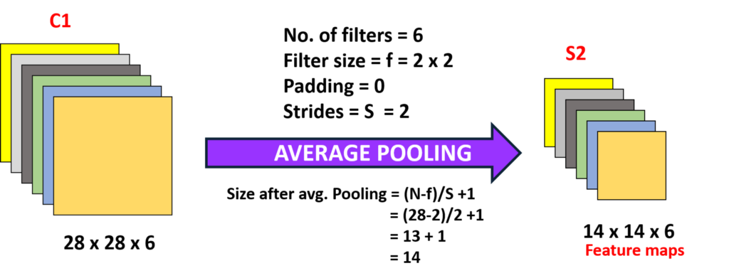
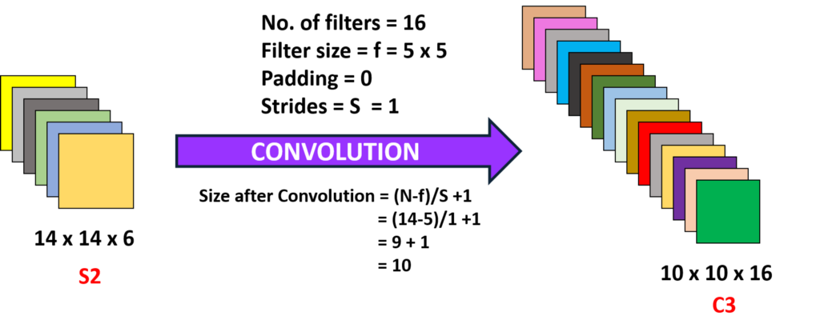
Layer C1
A convolutional layer with 6 feature maps of size 28x28
Each unit in each feature map is connected in a similar way as C1 and S2
C1 contains 156 trainable parameters and 122,304 connections.
Layer S2
A subsampling layer with 6 feature maps of size 14x14
Each unit in each feature map is connected to a 2x2 neighborhood in the corresponding feature map in C1
Layer C3
A convolutional layer with 16 feature maps of size 10x10
Each unit is connected to several 5x5 neighborhoods at identical locations

Slide 8
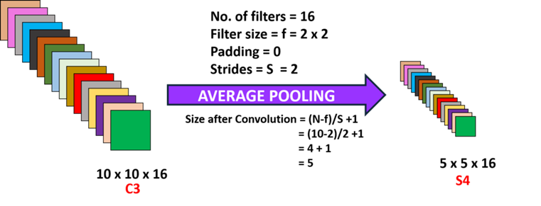
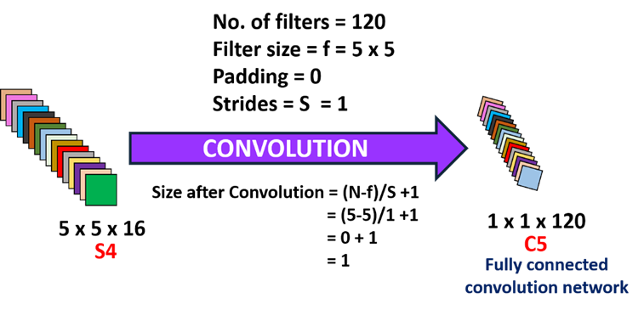
Layer S4
A sub-sampling layer with 16 feature maps of size 5x5
The size of the feature maps prevents connections from the input from falling off the boundary
S4 contains 32 trainable parameters and 2000 connections.
Layer C5
A convolutional layer with 120 feature maps of size 1x1
C5 contains 48120 trainable connections.

Slide 9
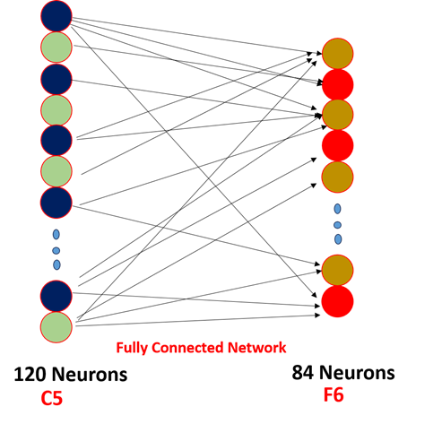
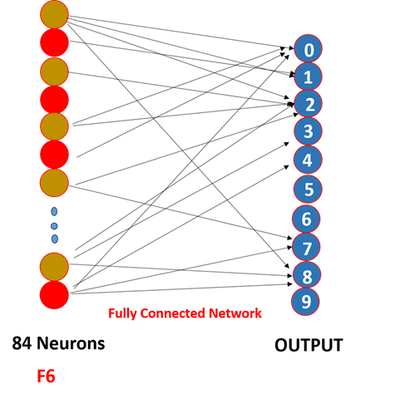
Layer F6
84 fully connected units
Output Layer
10 RBF(one for each class digit)
Radial Basis Function

Slide 10
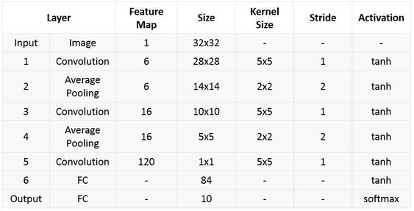

Slide 11
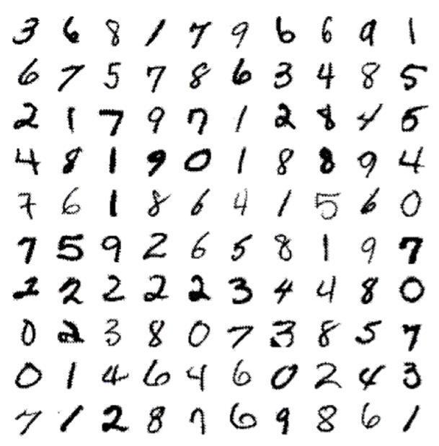
A. Database: The Modified NIST set
NIST – National Institute of Standards and Technology database
MNIST database
Handwritten digits
Subset of NIST dataset
Original images
Black and White
20 x 20 pixel
MNIST
Training Set
60,000
Test Set
10,000
Sample image from MNIST test dataset

Slide 12
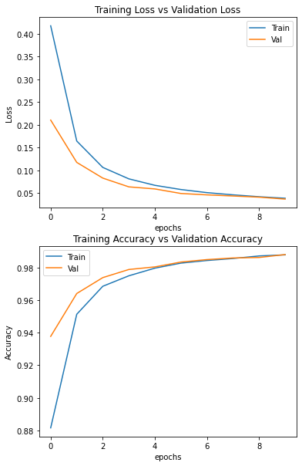
RESULTS
LeNet – 5
10 iterations
Influence of training set
Artificially generated more training examples
60,000 original patterns
540,000 instances of distorted translations
Horizontal and vertical translations
Scaling
Squeezing

Slide 13
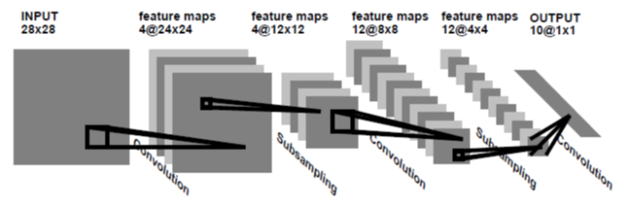
A Small Convolutional Network: LeNet - 1
LeNet – 1
For comparison purposes
Images – 16 x 16 pixels and centred in the 28 x 28 input layer

Slide 14
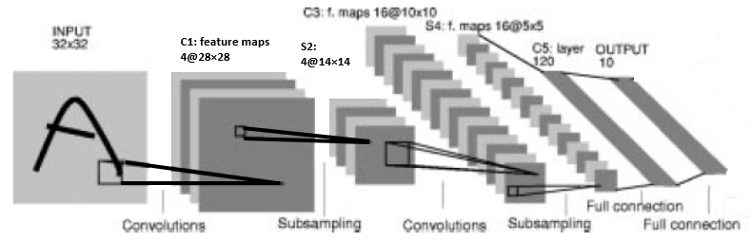
LeNet - 4
LeNet – 4
For larger size of the training set
Contain 4-level feature maps, followed by 8 subsampling maps, 16 feature maps, followed by 16 subsampling maps, followed by a fully connected layer with 120 units, followed by the output layer (ten units)
Improve rejection performance

Slide 15
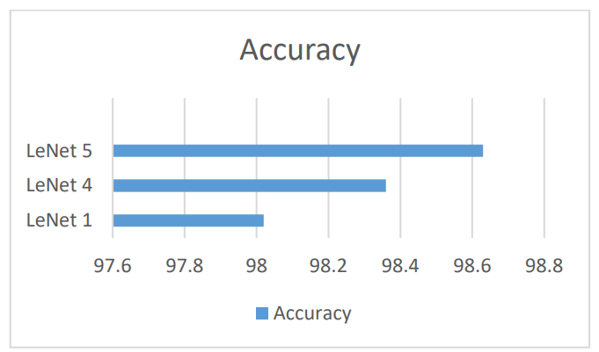
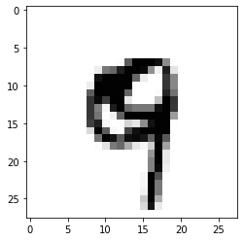
Comparison
Accuracy of the Classifiers on the 10 000 for number ‘9’
LeNet – 5
LeNet – 4
LeNet – 1

Slide 16
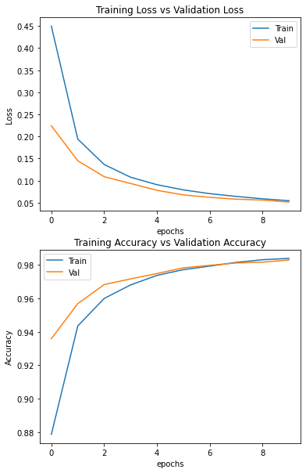
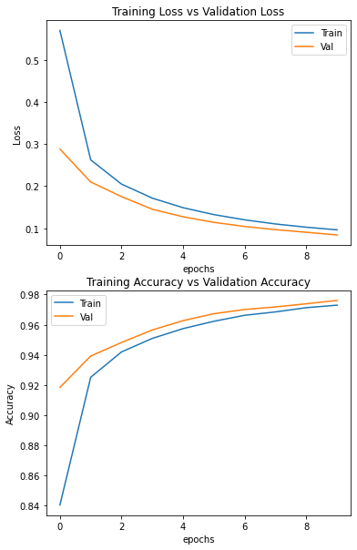
LeNet - 5
LeNet - 4
LeNet - 1

Slide 17
CONCLUSIONS
In neural networks, backpropagation allows us to efficiently compute the gradients on the connections of the neural network, with respect to a loss function.
Hand crafted should be replaced by an automatic learned features.
Large sized systems can be learned by gradient-based methods with efficient back propagation.

Slide 18

THANK YOU

